Slide 1
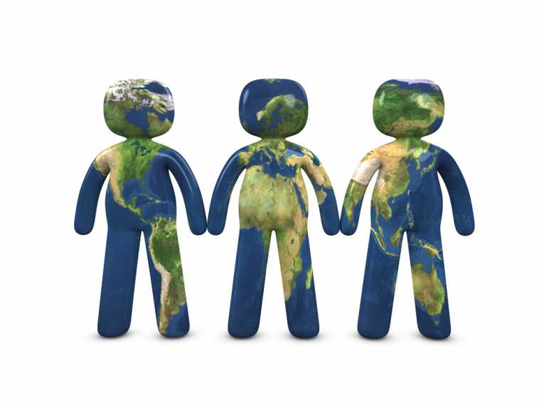
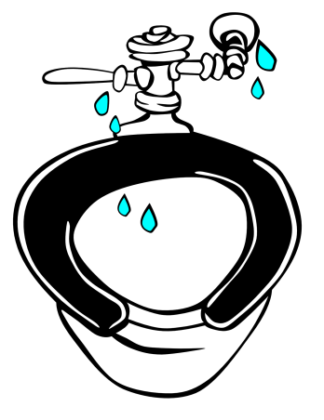
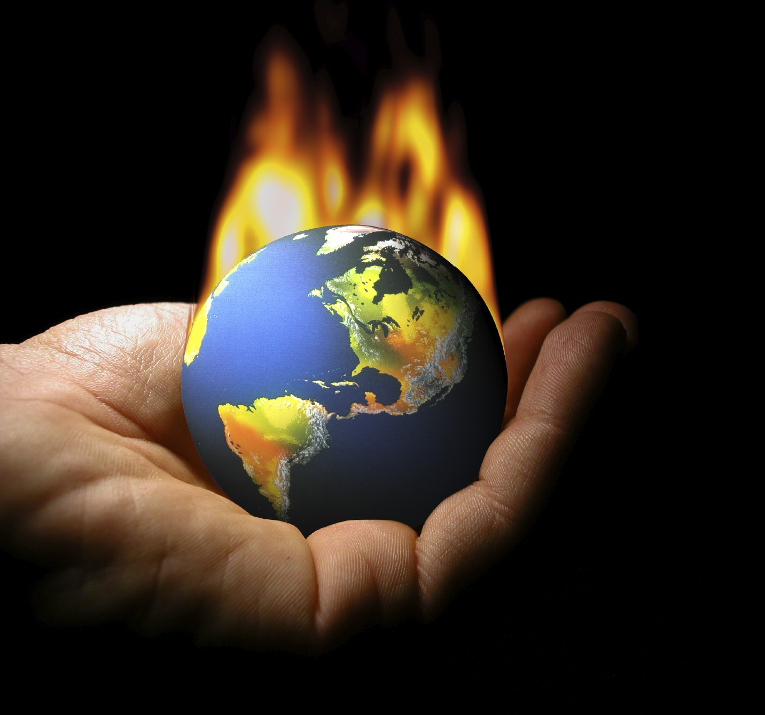
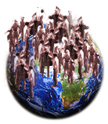
70%
Akissa Bahri, 2013
Notes:
We need to reimagine urban water management – ESPECIALLY IN DEVELOPING COUNTRIES
With climate change and exponential population growth in cities, traditional “user” approach, which is a linear approach to water and sanitation management is not sustainable–crisis looming;
Cities accommodate half the world’s population. By 2050, 70% of the global population is expected to live in urban areas (UN-Habitat, 2009);
Water security is not assured for billions of people. By 2030, 47% of the world population will be living in areas of high water stress.

Slide 2
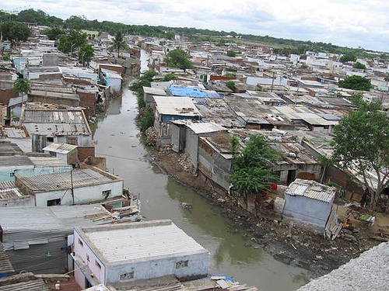
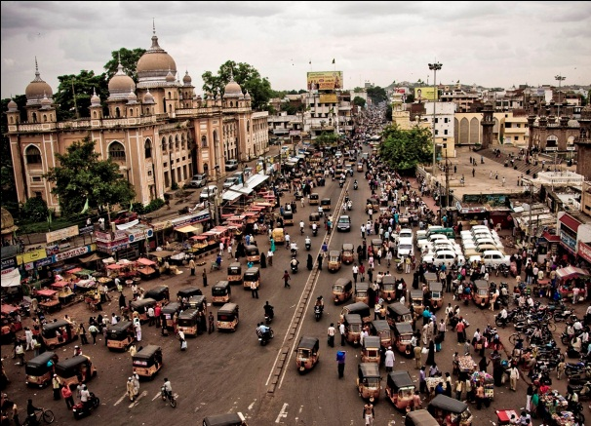
!!!
Notes:
This is particularly true for developing countries where the impact will be more severe in their cities because of the proliferation of slums (EX. HYDERABAD; KIBERA);
Indeed, much of current urban growth is occurring in developing countries, and concentrated in informal settlements and slum areas (UN-Habitat, 2011);
About 830 million people, around one-third of the world’s urban population, live in slum conditions. Much of urban growth is expected to come from unplanned settlements or slums in and around cities.
This leads to two cities in one: anarchic development, informal settling: massive urban growth dominated by uncontrolled informal and illegal spatial developments with urban poor majorities living in environmentally fragile areas without access to basic services such as water, sanitation, electricity and roads;
While progress being made in the attainment of Goal 7 targets 10 and 11, experience shows that provision for water and sanitation cannot be viewed in isolation but interrelated with urban planning.

Slide 3
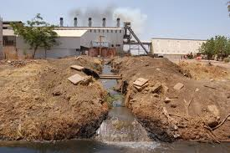
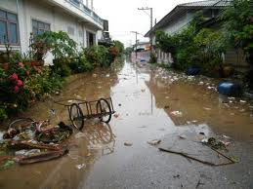
Notes:
For water, unplanned development means that water use is linear or “user focused”
Wastewater ends up being dumped, unmanaged and is NEITHER RECYCLED NOR REUSED in a planned manner.

Slide 4
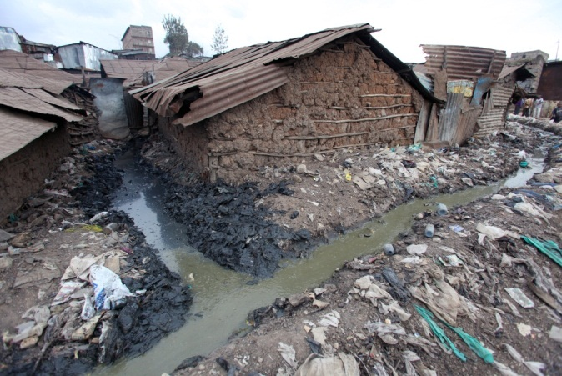
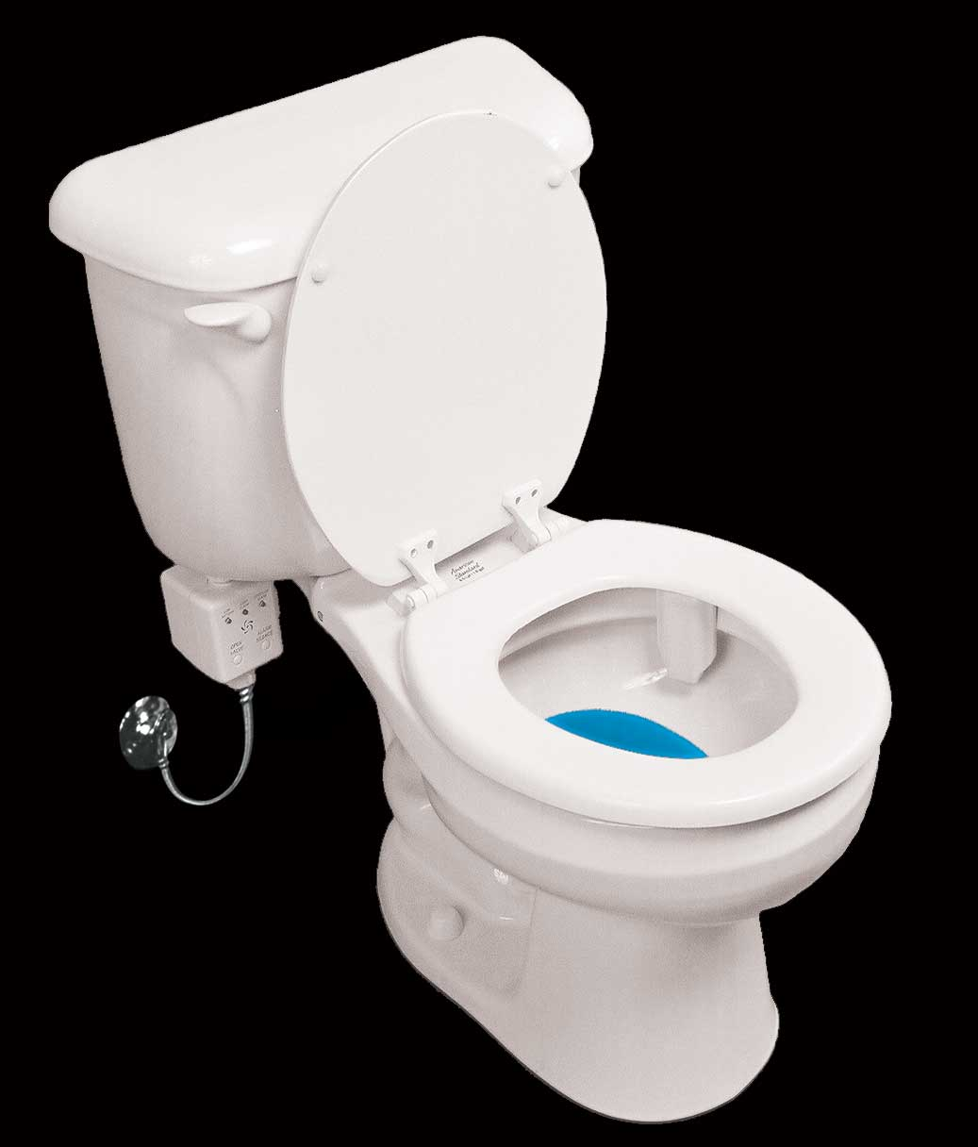
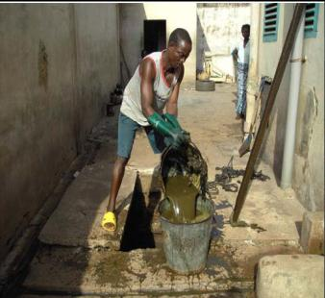
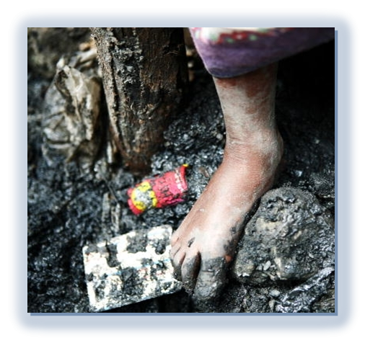
+60,000,000
Notes:
For sanitation, unplanned development means that sanitation services are improvised, unmanaged;
Of the 60 million people added to the world's towns and cities every year, most move to slums with no sanitation facilities.
Low coverage and open defecation
Inadequate collection
Problem of emptying
Lack of treatment plants
Financing issues

Slide 5
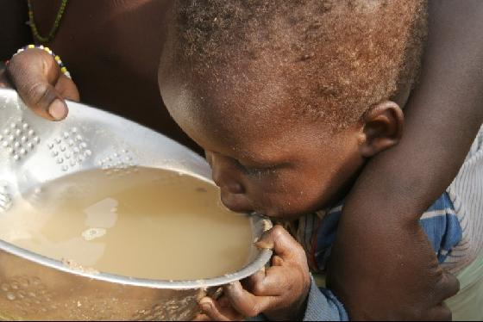
Notes:
Untreated water is wasted and polluting.
It pollutes livestock, crops, affects people’s health (water borne diseases, esp. in developing countries)
Pollution is the vector for avoidable disease and death. Every 20 seconds, a child dies from a water-related illness , i.e, 3.4 million people each year.
Nearly all deaths occur in the developing world

Slide 6
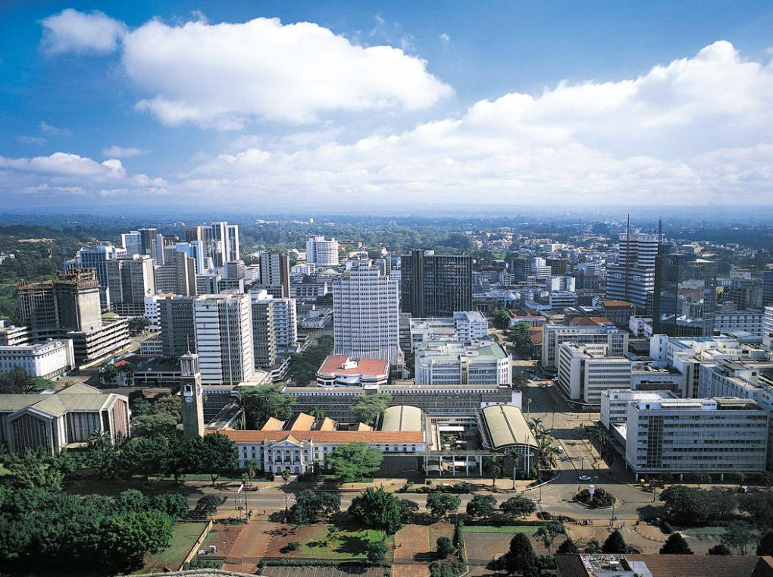
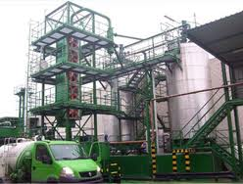
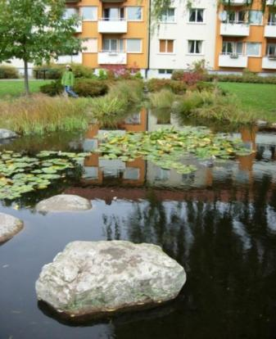
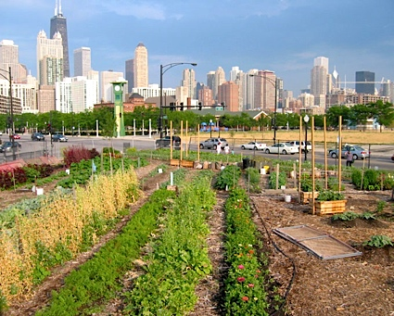
Notes:
The solutions are twofold:
(1) Move from linear to a circular urban metabolism system through integrated Urban Water Management; Integration within and beyond cities is required.
Integration of scales, sectors, sources and services
Cities shifting from ‘resource users’ to ‘resource managers’
(1.1) Integration within cities - sources and services: Water security demands that policies on housing, energy, land- and waterscape design, agriculture (both urban and rural) and waste management are aligned and contribute to optimal use of water resources.
IUWM seeks to change the impact of urban development on the natural water cycle, by managing the urban water cycle as a whole; a more efficient use of resources can be achieved by providing not only economic benefits but also improved social and environmental outcomes.
The approach is to establish an inner, urban, water cycle loop through the implementation of reuse strategies.

Slide 7
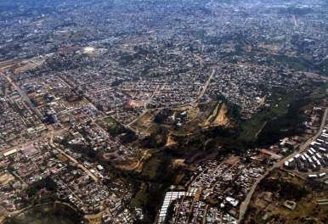
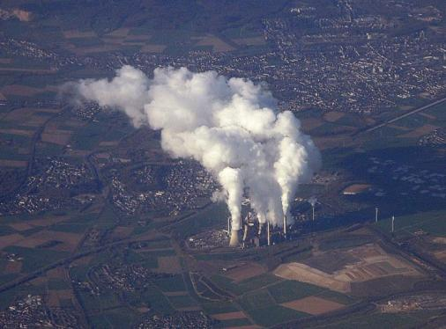
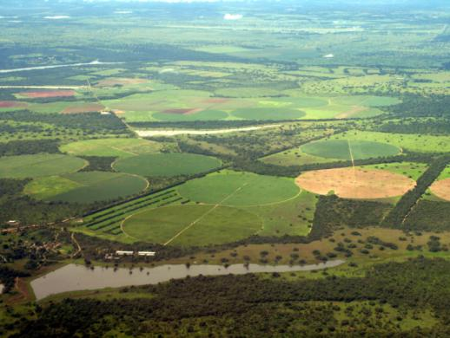
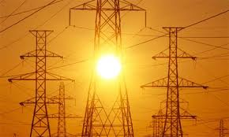
Notes:
(1.2) Integration beyond cities - scales, sectors: Cities, industry, energy, agriculture and other sectors reliant on common water resources need to act in concert beyond their own boundaries to address shared risks and opportunities to optimize urban water and to invest in building more resilient basins.

Slide 8
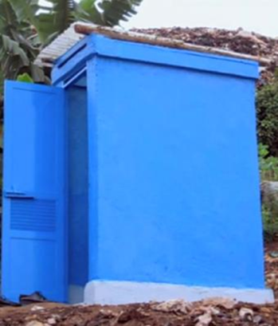
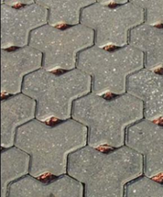
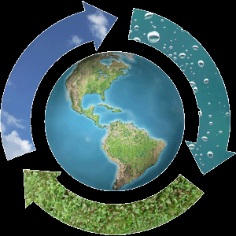
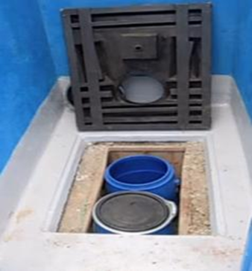
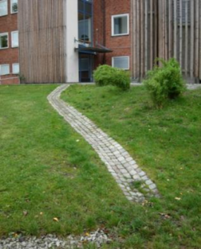
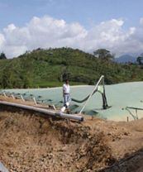
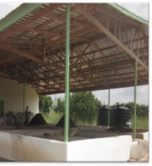
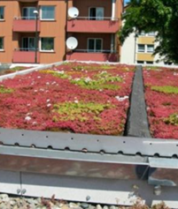
S
T
C
T
R
R
Notes:
Capture, Store, Transport, Treat, Reuse, Recycle Using Integrated Innovations

Slide 9
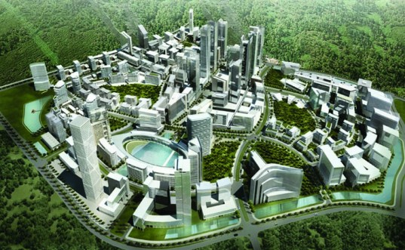
GRAND CHALLENGE: Educate a new generation of urban water leaders and managers for a governance that will promote reforms, as well as new technologies and business models to build cities of the future!
Notes:
How do we get to the Cities of the Future?
The Grand Challenge is: Educate a new generation of urban water leaders and managers for a governance that will promote reforms, as well as new technologies and business models to build cities of the future!

