Slide 1
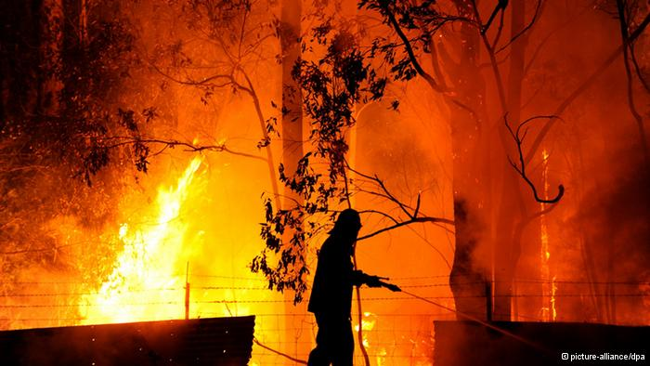
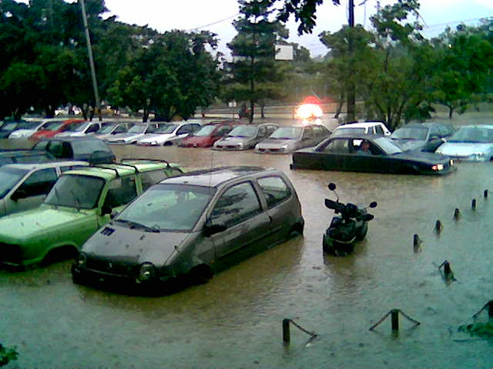
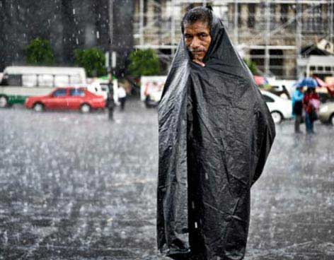
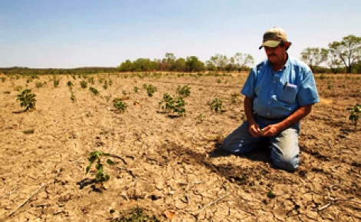
Source: Google Images
Notes:
A changing climate leads to changes in extreme weather and climate events of high impact in our society

Slide 2
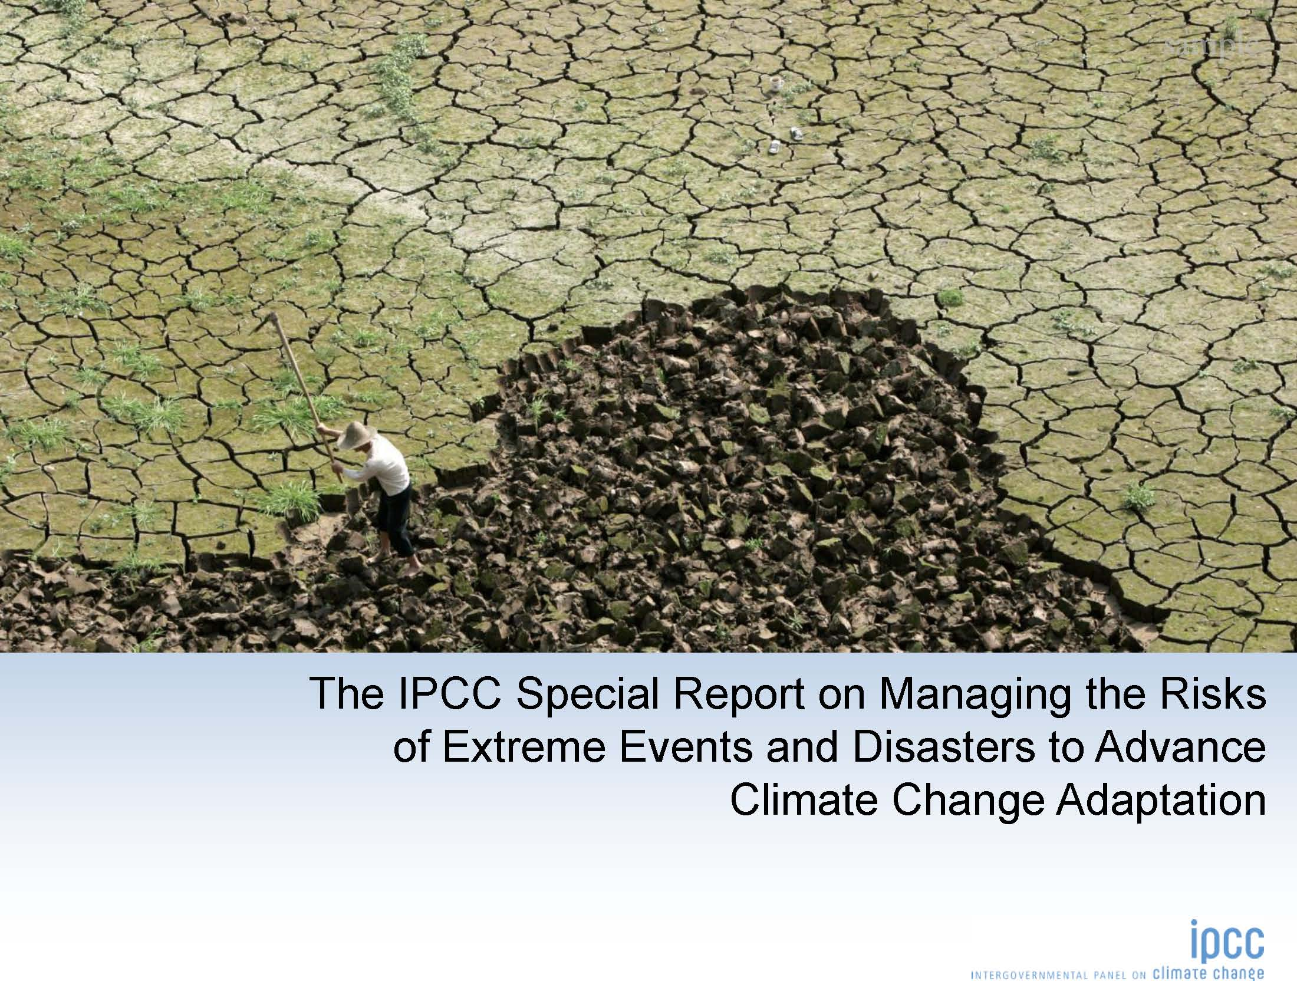
Notes:
One of the grand challenges that “coping with Climate Change” encompasses is the challenge of managing the risk of disasters promoted by extreme events in the context of Climate Change
Recently IPCC has delivered a special issue on this topic. I will discuss how climate change is stressing the current structures for disaster risk management and I will describe some possible solutions, innovations and new practices needed to reduce disaster risk

Slide 3
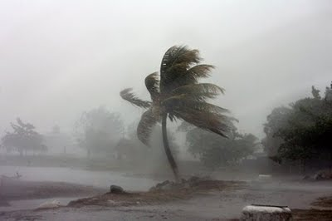

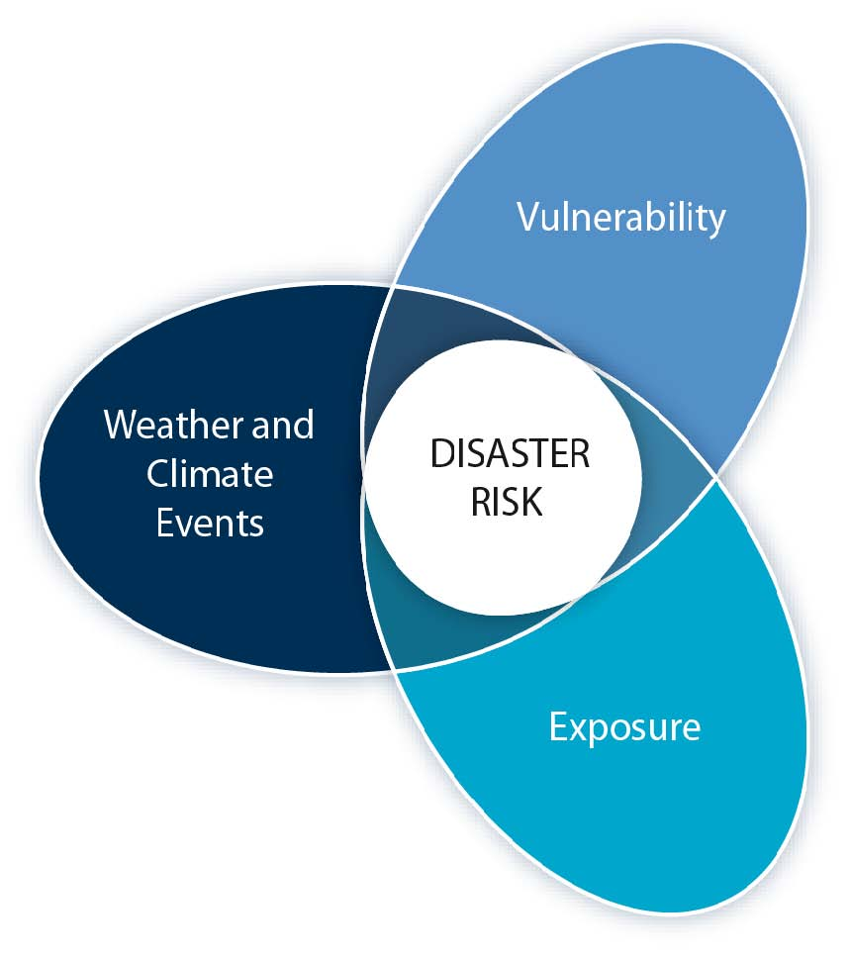
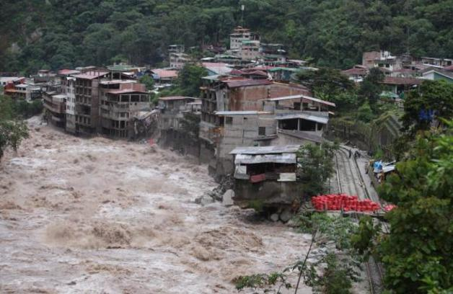

Source: Google Images
Notes:
Impacts from weather and climate events depend on: nature and severity of the event, vulnerability and exposition
Increasing vulnerability, exposure, or severity and frequency of climate events increases disaster risk
Disaster risk management and climate change adaptation can influence the degree to which extreme events translate into impacts and disasters

Slide 4
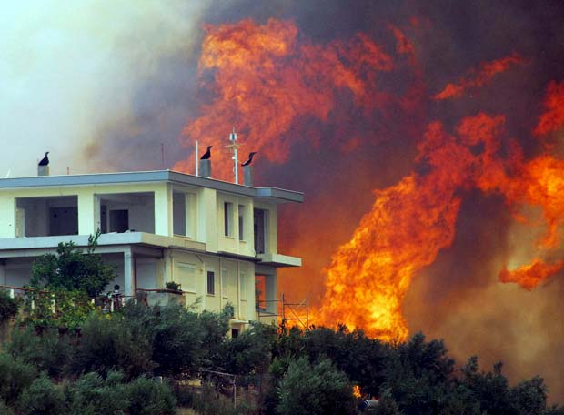
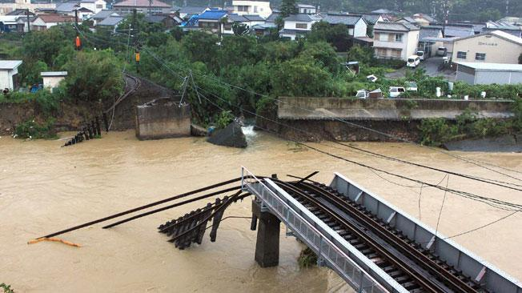
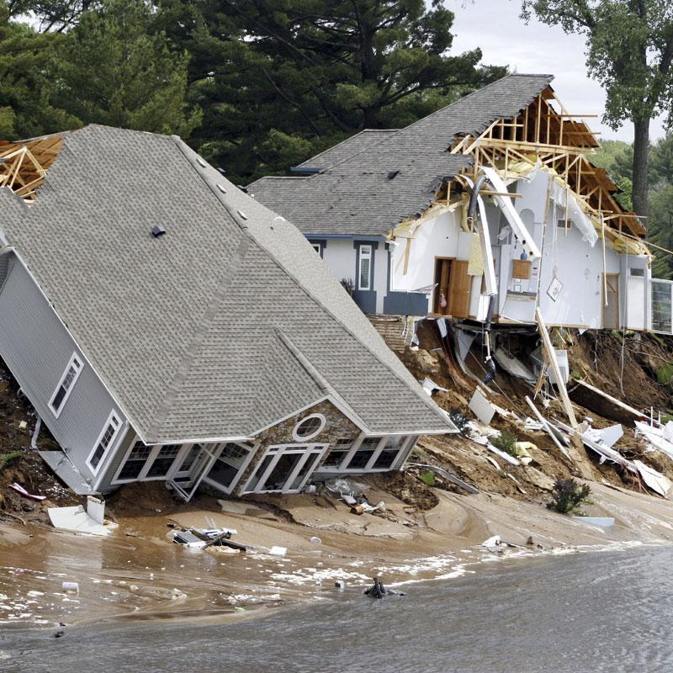
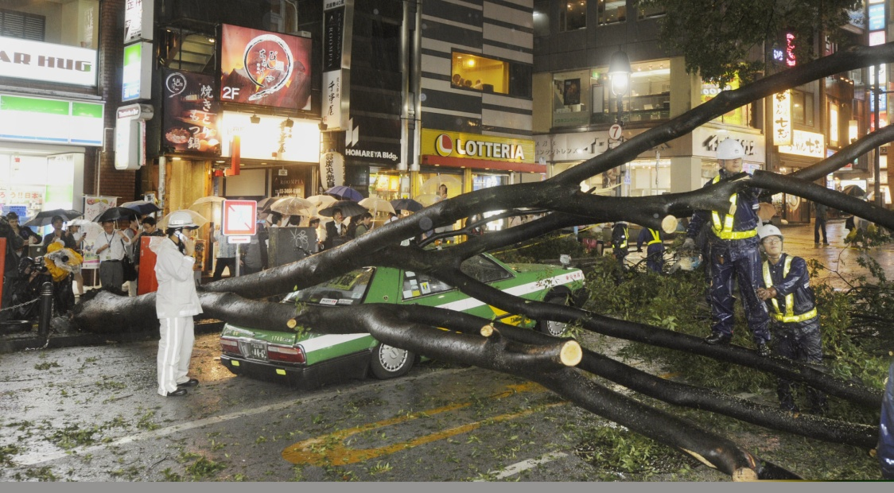
Source: Google Images
Notes:
Economic losses from climate-related disasters have increased,
Economic disaster losses are higher in developed countries

Slide 5
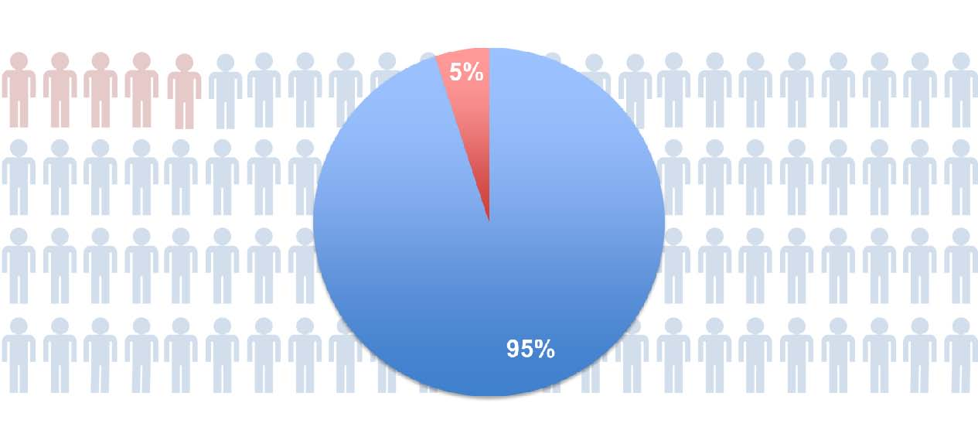
Notes:
Increasing exposure of people and assets has been the major cause of changes in disaster losses
Fatalities are higher in developing countries From 1970-2008, over 95% of natural-disaster-related deaths occurred in developing countries

Slide 6
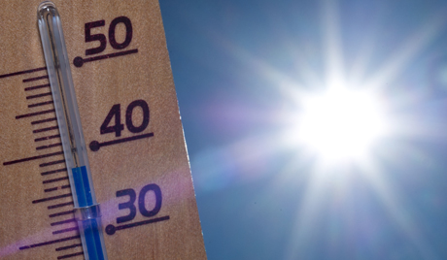
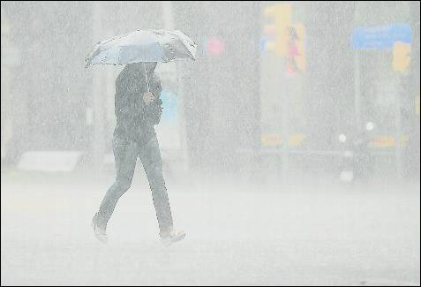
Source: Google Images
Notes:
Since 1950, extreme hot days and heavy precipitation have become more common
There is evidence that anthropogenic influences, including increasing atmospheric greenhouse gas concentrations, have changed these extremes
Climate models project more frequent hot days and there will be more heavy rain events throughout the 21st century

Slide 7

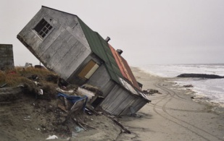

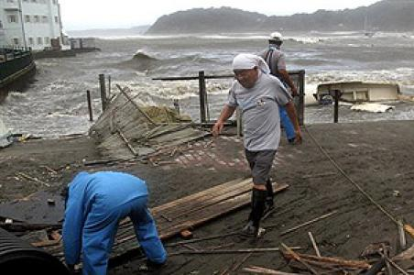
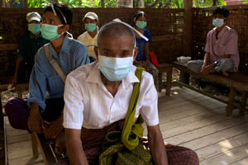


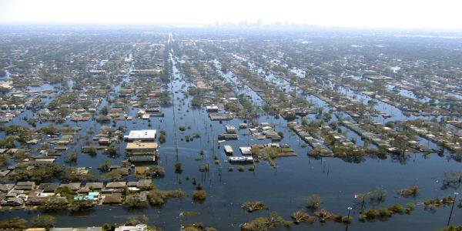
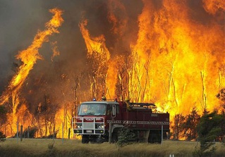
Source: Google Images
Notes:
Effective risk management and adaptation are tailored to local and regional needs and circumstances
Each region has unique vulnerabilities and exposure to hazards
Effective risk management and adaptation address the factors contributing to exposure and vulnerability

Slide 8
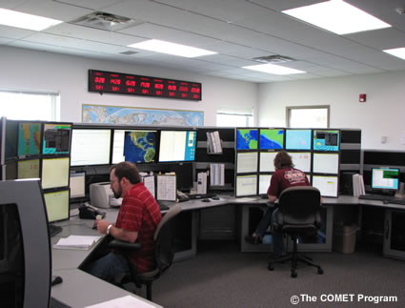
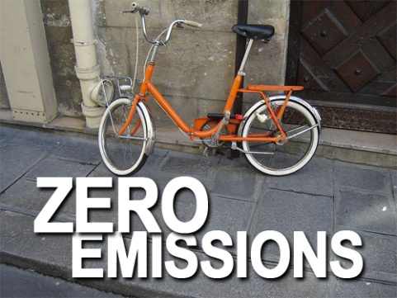
GRAND CHALLENGE: REDUCING DISASTER RISKS IN A CLIMATE CHANGE CONTEXT
Source: Google Images
Notes:
Information on vulnerability, exposure, and changing climate extremes can together inform adaptation and disaster risk management
Solutions, innovations and new practices have been identified as relevant and needed to disaster risk reduction
Improved forecasting for warning systems
Reduction of greenhouse gas emissions

Slide 9



GRAND CHALLENGE: REDUCING DISASTER RISKS IN A CLIMATE CHANGE CONTEXT
Source: Google Images
Notes:
Poverty reduction
Better education and awareness
Sustainable development

Slide 10
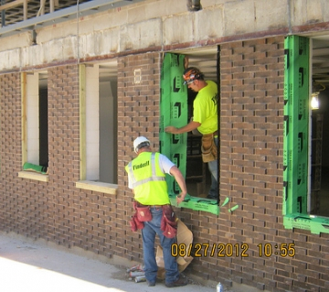


GRAND CHALLENGE: REDUCING DISASTER RISKS IN A CLIMATE CHANGE CONTEXT
Source: Google Images
Notes:
Asset relocation
Weather-proofing assets
Early warning systems
Learning-by-doing and low-regrets actions can help reduce disaster risks now and also promote future climate change adaptation

