Slide 1
IAP Young Physician Leaders (YPL) Webinar
COVID-19 Vaccine Hesitancy
Dr. Juan Carlos Núñez Enríquez (YPL 2016)
Mexico City

Slide 2
Despite vast improvements in global vaccination coverage during the last decade, there is a growing trend in vaccine hesitancy and/or refusal globally
Vaccines are among the most cost-effective health technologies of all time
Wagner CE et al. Front Public Health. 2020;8:614113

Slide 3
By choosing to be vaccinated, an individual protects themself but also protects their community by preventing disease transmission.
Vaccines save 5 lives every minute
Lewandowsky, S. et al. (2021). The COVID-19 Vaccine Communication Handbook.

Slide 4
Vaccine refusal factors
Underestimated risk of disease
Overestimated risk of vaccine-induced adverse effects
Risk perceptions are rightly placed as core concepts in theories of health behavior
Brewer NT et al. Health Psychol. 2007 Mar;26(2):136-45.

Slide 5
Vaccine hesitancy
Doubts about a specific vaccine
Complete rejection

Slide 6
People are more likely to accept vaccination when:
They perceive a high risk of contracting the disease when unvaccinated
Increased personal vulnerability to develop the disease
Greater severity of the disease
Brewer NT et al. Health Psychol. 2007 Mar;26(2):136-45.

Slide 7
COVID-19 pandemic

Slide 8
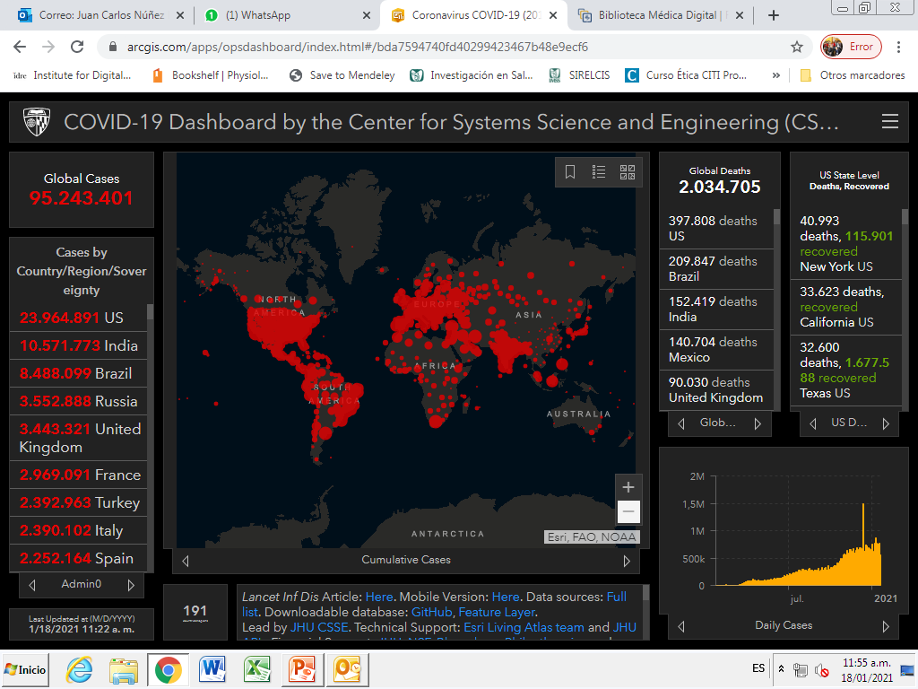

Slide 9
COVID-19 Vaccines Development
Recruitment period was short compared with the usual 12-18 months period for other vaccines
More participants than many other vaccines
It was no delay between completion of testing and rollout – Pharmaceutical companies
Funding was not an obstacle
Side effects are transient (24-48 hours)
Serious side effects are extremely rare
Lewandowsky, S. et al. (2021). The COVID-19 Vaccine Communication Handbook.

Slide 10
Confidence and Receptivity for
COVID-19 Vaccines: Systematic Review
US and other countries
126 studies and surveys were selected
Declining vaccine acceptance (from >70% in March to <50% in October
Lin C et al. Vaccines (Basel). 2020 Dec 30;9(1):E16.

Slide 11
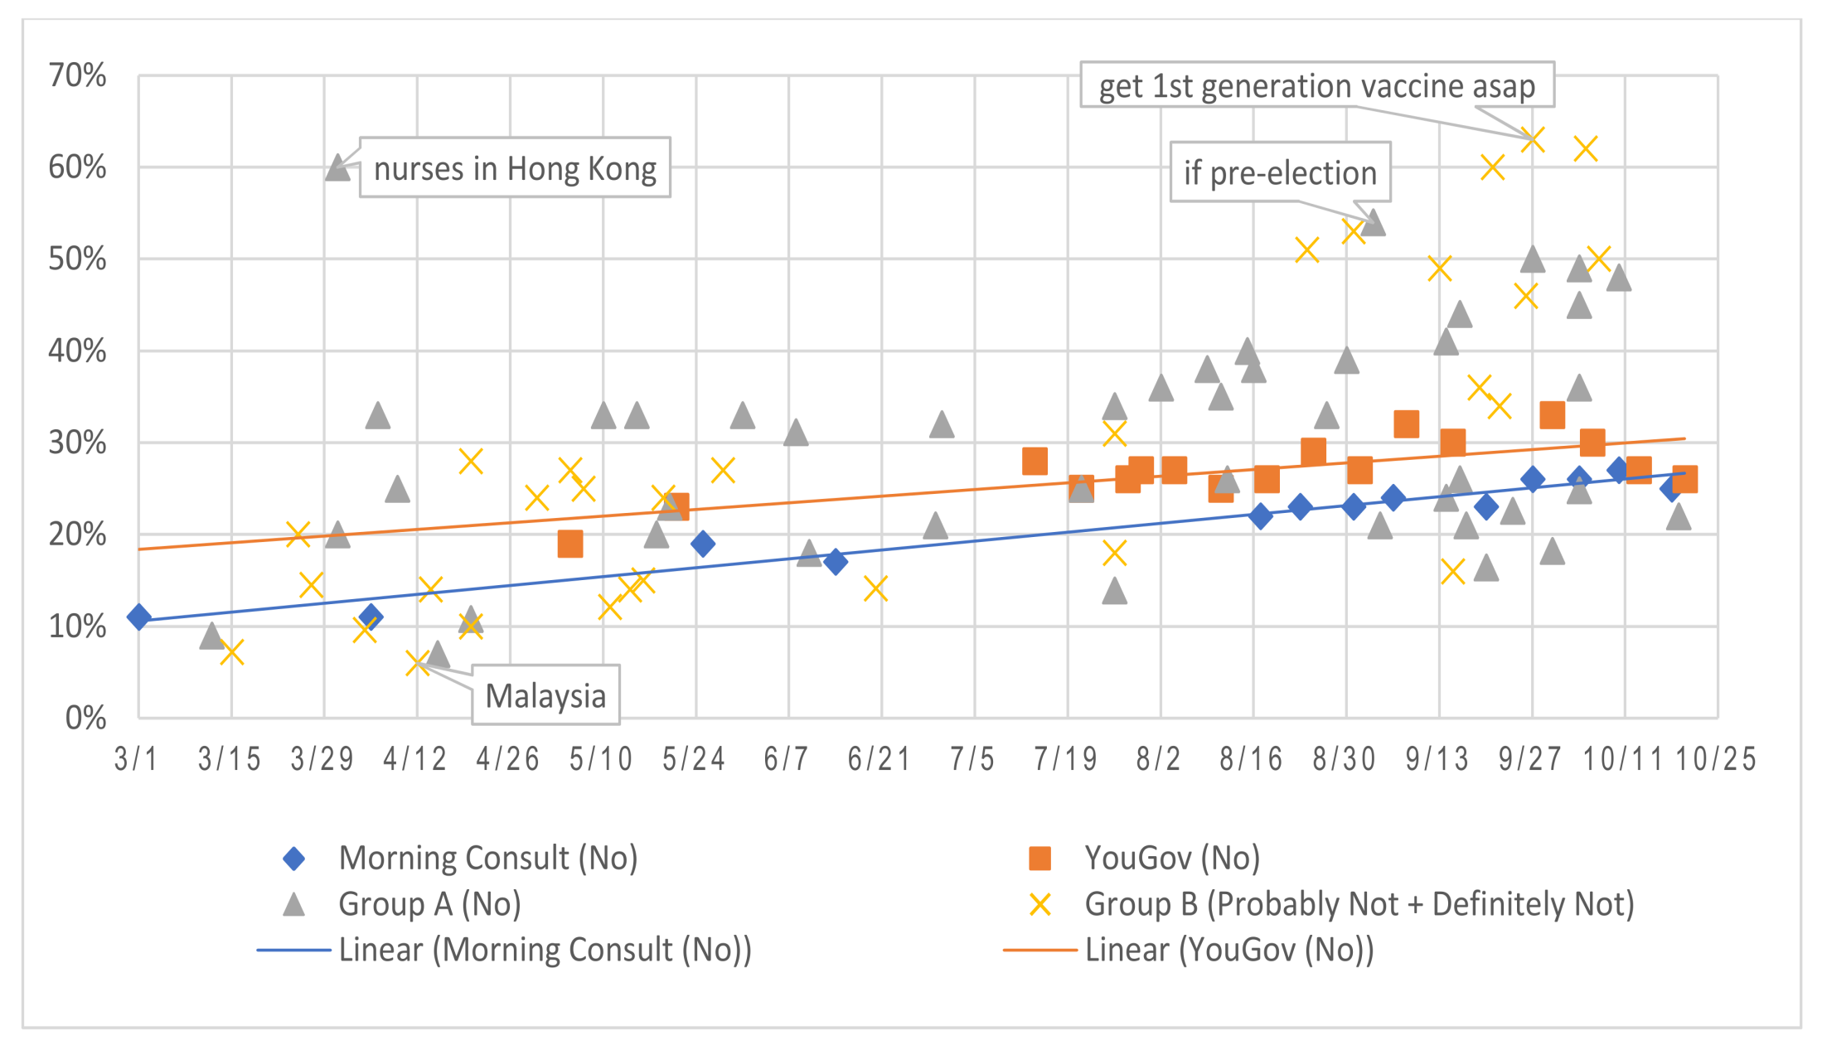
Percentages of expressed refusal or hesitancy to a vaccine intention question
Lin C et al. Vaccines (Basel). 2020 Dec 30;9(1):E16.

Slide 12
The Role of Healthcare Professionals
They are the most trusted advisors and influencers of vaccination decisions
They help establish vaccination as the norm
They should switch rapidly to acknowledging and empathizing with the person’s concerns.
Strong recommendations are effective:
‘I can see that you need your COVID vaccine today’
‘You are due for your second COVID vaccine’
Chung, Y. et al. Maternal and Child Health Journal, 21, 2178-2187.

Slide 13
Main factors associated with an increased hesitanty about
COVID-19 vaccines
Ideological reasons
  because COVID-19 and the response to it have become politicized in some countries.
Vaccination opponents- Conspiracy theories
  anti-vax extremists make up only about a third of respondents in surveys who said they would not vaccinate
People who has experienced medical malpractice affecting current trust
  Marginalized populations: immigrants, low-income subjects, etc.
Lewandowsky, S. et al. (2021). The COVID-19 Vaccine Communication Handbook.

Slide 14
Main factors associated with an increased hesitanty about COVID-19 vaccines
4. People who let others to be vaccinated while they receive the benefits of herd immunity without getting the vaccine.
5. Young and Healthy individuals believing they are not at risk from COVID-19
Lewandowsky, S. et al. (2021). The COVID-19 Vaccine Communication Handbook.

Slide 15
Thank you very much

