Slide 1

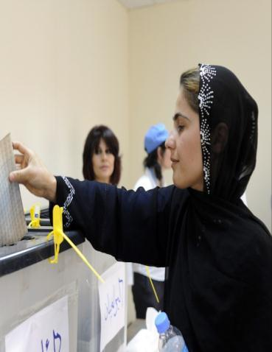

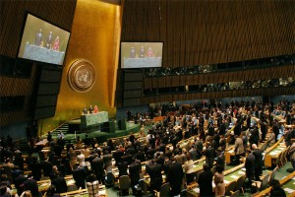

Post-2015 Development Agenda
THE WORLD WE WANT
(status: 20 February 2012)
© United Nations Development Programme

Slide 2

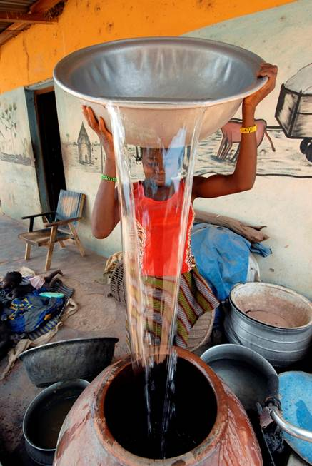
OVERVIEW
Vision for a future development framework
Process to support
formulation of the Post-2015 Agenda
Way forward

Slide 3

The MDGS: 2001-2015
Millennium Declaration (Sept. 2000)
Millennium Development Goals (2001)
  Eradicate extreme poverty & hunger
  Achieve universal primary education
  Promote gender equality & empower women
  Reduce child mortality
  Improve maternal health
  Combat HIV/AIDS, malaria& other diseases
  Ensure environmental sustainability
  Develop a global partnership for development
MDG deadline (2015)
What next?

Slide 4

UN TASK TEAM ON POST-2015 (UN TT)
Representatives of over 60 UN entities and international organisations, to coordinate the system and propose a unified vision
To support Member States & provide analysis and recommendations on monitoring and accountability, and global partnerships
Report “Realizing the Future We Want for All” submitted to UN Secretary-General in June 2012

Slide 5
Environmental sustainability
Peace and Security
Inclusive social development
Inclusive economic development
Human rights
Equality
Sustainability
UN System Task Team proposes to keep MDG format: Goals,
targets, indicators
un.org/en/development/desa/policy/untaskteam_undf/index.shtm

Slide 6
Post-2015 Process
Mandates
  Defined at MDG Summit 2010 & Rio+20 Conference 2012
  Open and inclusive consultative process
Leadership
  Member States: prerogative to deliver framework
  UN Secretary-General: to present vision to General Assembly in September 2013 building upon UN system’s work and consultation processes

Slide 7
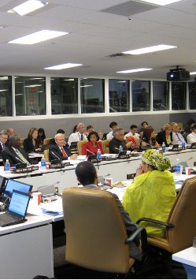
HIGH LEVEL PANEL ON POST-2015 (HLP)
Composed of 27 eminent persons, to advise the UN Secretary-General on a ambitious yet achievable development agenda post-2015
Work informed by UN Task Team report, research, outcomes of major processes and civil society outreach
It will submit a report to the UN Secretary-General by 31 May 2013
hlp2015.projektserver.org

Slide 8

OPEN WORKING GROUP ON SDGs (OWG)
30 seats composed of 70 representatives nominated by Member States
Tasked to develop a proposal for Sustainable Development Goals (SDGs) in coherence with Post-2015 UN development agenda
It will submit a report, to the 68th session of the General Assembly (Sept2013–Sept2014)

Slide 9
OWG MEMBERSHIP
1. Algeria/Egypt/Morocco/Tunisia 2. Ghana 3. Benin 4. Kenya 5. United Republic of Tanzania 6. Congo 7. Zambia/ Zimbabwe 8. Nauru/Palau/Papua New Guinea 9. Bhutan/Thailand/Viet Nam 10. India/Pakistan/Sri Lanka 11. China/Kazakhstan/Indonesia 12. Cyprus/Singapore/UAE 13. Bangladesh/Republic of Korea/Saudi Arabia 14. Iran/Japan/Nepal 15. Colombia/Guatemala | 16. Bahamas/Barbados 17. Guyana/Haiti/Trinidad & Tobago 18. Mexico/Peru 19. Brazil/Nicaragua 20. Argentina/Bolivia/Ecuador 21. Australia/Netherlands/UK 22. Canada/Israel/USA 23. Denmark/Ireland/Norway 24. France/Germany/Switzerland 25. Italy/Spain/Turkey 26. Hungary 27. Belarus/Serbia 28. Bulgaria/Croatia 29. Montenegro/Slovenia 30. Poland/Romania

Slide 10
UN DEVELOPMENT GROUP:
OPEN AND INCLUSIVE GLOBAL CONSULTATIONS
Post-2015
development agenda
IS IT MORE INCLUSIVE?
IS IT MORE EQUITABLE?
IS IT SUSTAINABLE?
UNDG Initiative based on 3 pillars of work:
1. National consultations:
Lead by the UN Resident Coordinators and building on on-going consultations, they will feed into the post-2015 formal process.
2. Thematic consultations:
with academia, media, private sector, employers, trade unions, civil society, and decision makers on current central challenges to development .
3. Global Outreach:
Using web, social media, mobile telephony and other means to allow open interaction and information exchange among a range of stakeholders.

Slide 11
UNDG National Consultations
Africa (S, E & W) | Asia & Pacific | Latin America & Caribbean | Arab States | Eastern Europe & CIS
Angola, Benin Burkina Faso, Burundi CAR, DRC Ethiopia, Gabon Gambia, Ghana Kenya, Liberia Mali, Malawi Mauritania, Mauritius Mozambique, Niger Nigeria, Rwanda Senegal, South Africa Tanzania, Togo Uganda, Zambia | Bangladesh Bhutan Cambodia China India Indonesia Iran Pakistan Philippines PNG Samoa Solomon Islands Thailand Timor-Leste Vietnam | Bolivia Brazil Colombia Costa Rica Dominican Republic Ecuador El Salvador Guatemala Honduras Peru Santa Lucia | Algeria Djibouti Egypt Iraq Jordan Morocco Sudan Yemen | Albania Armenia Azerbaijan, Belarus Kazakhstan Kyrgyzstan, Kosovo Moldova Montenegro, Tajikistan Turkey Serbia Turkmenistan, Ukraine

Slide 12











UNDG THEMATIC CONSULTATIONS
Growth & Employment
Energy
Population Dynamics
Education
Inequalities
Water
Food Security & Nutrition
Governance
Conflict & Fragility
Health
Environmental Sustainability

Slide 13





GLOBAL OUTREACH
worldwewant2015.org
unglobalcompact.org
myworld2015.org
beyond2015.org
unsdsn.org

Slide 14
UNSG submits
report to UNGA
First meeting of
High-level Panel
Report submitted to SG
High-level Panel
established
Post-2015 Framework
Mandated by 2010 MDG Summit
UNDG 1st report
UNDG 2nd report
UNDG next steps
31 July 2012
Sep 2012
Spring 2013
Sep 2013
Sep 2014
SDG Process
Mandated by Rio+20 Outcome Doc
Working Group on SDG established
Working Group report submitted to UNGA
(between Sep 2013 and Sep2014)

