Slide 1
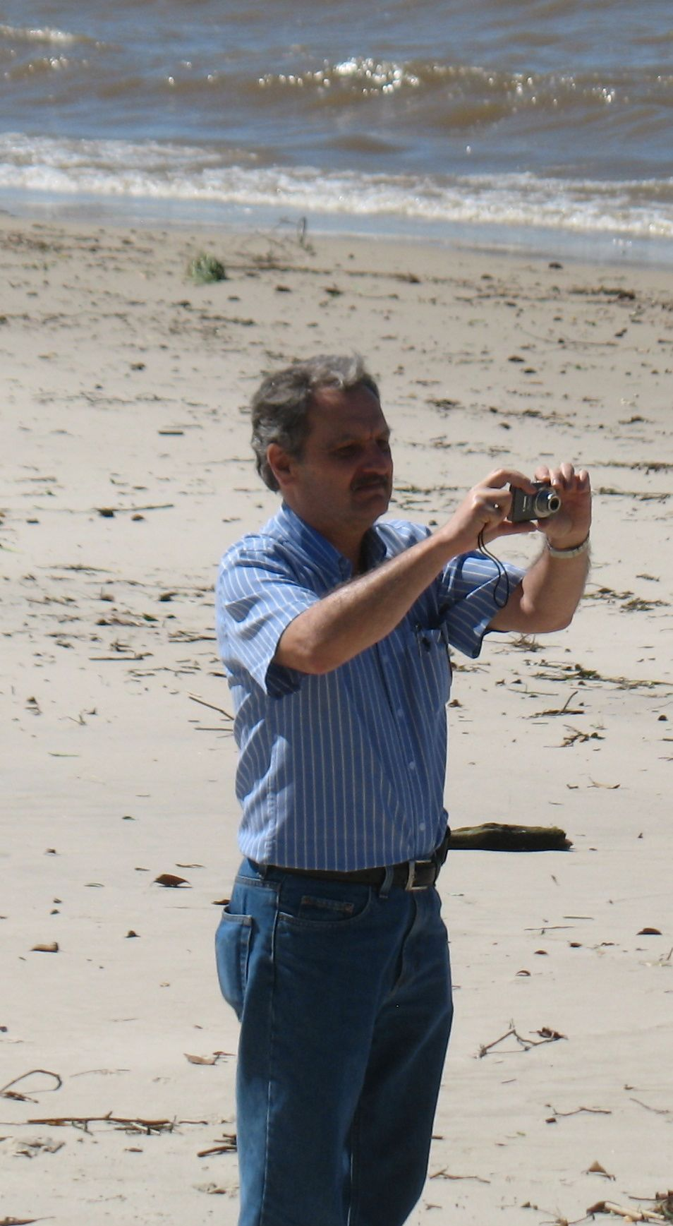
Science Academies Working Together
Grand Challenges of Poverty Eradication & Sustainability
J

Slide 2
Why Is The Voice Of Science Crucial In Addressing 21st century challenges?
Science is the world’s most successful means of knowledge creation
  Deals exclusively with arguments based on evidence
  Results subject to independent confirmation by others

Slide 3
Why are Academies Important?
Academies are merit based and include the scientific leadership within a country
Academies are self renewing institutions, free from political interference.
Academies have the credibility to inform the public and policy makers about looming problems and potential solutions

Slide 4
The power of networks
Global Network of Science Academies (IAP)
  108 Members
  Speaks for the world’s science academies on major issues
Why regional networks?
  The major regions of the world are heterogeneous in cultures, environments and levels of economic development
  Can translate global issues into a regional context
  Reduces transaction costs
  Increases academy engagement

Slide 5
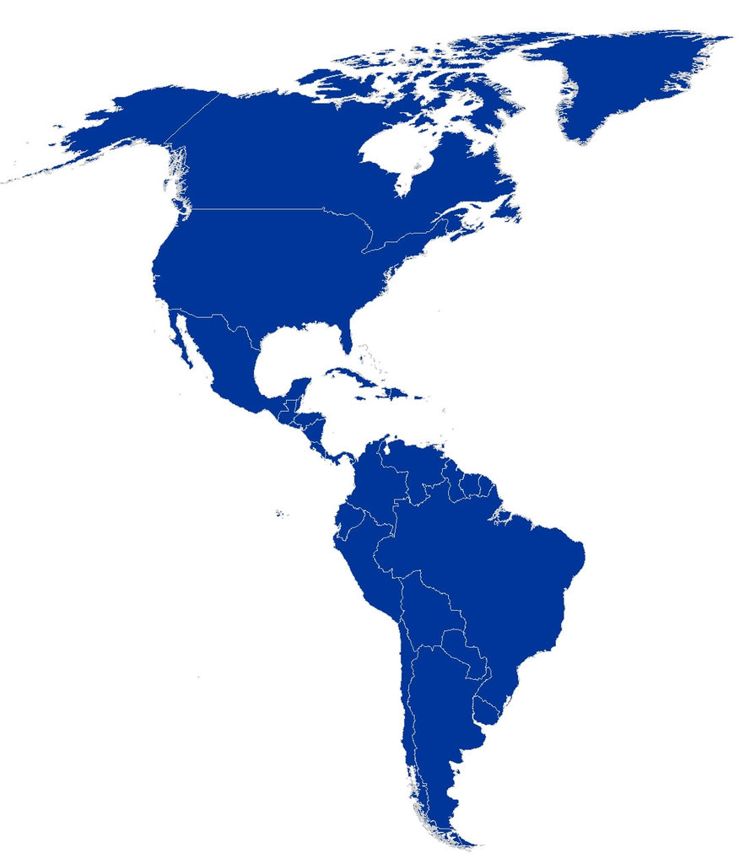
The InterAmerican Network of Academies of Science (IANAS)
North America
The Academies of Arts, Humanities and Sciences of Canada *
US National Academy of Sciences
Mexican Academy of Sciences *
Central America and the Caribbean
Cuban Academy of Science
Academy of Sciences of the Dominican Republic
Academy of Medical, Physical and Natural Sciences of Guatemala
National Academy of Sciences of Costa Rica
Nicaraguan Academy of Sciences
South America
Academy of Physical, Mathematical and Natural Sciences of Venezuela
Colombian Academy of Exact, Physical and Natural Sciences
Brazilian Academy of Sciences *
National Academy of Sciences of Peru
National Academy of Sciences of Bolivia
Chilean Academy of Science *
National Academy of Exact, Physical and Natural of Argentina *
Regional Members and Other Future Members
Latin American Academy of Science APANAC, Panama
Caribbean Academy of Sciences Academy of Science of Ecuador
Caribbean Scientific Union Academy of Science or Uruguay

Slide 6
IANAS Goals
Enhancing human resource development in science, technology and health by improving the quality of science education;
Developing programs that employ science to provide solutions to major societal challenges such as water resource needs, energy development, disease surveillance, disaster mitigation, biodiversity loss, environmental pollution, and climate change;
Linking with IAP/ IAMP / IAC and others to organize regional workshops aimed at bringing the recommendations of IAC studies to policy makers;
Promoting STI (science, technology and innovation) strategies for economic development, poverty reduction and quality of life at the national and regional levels.

Slide 7
IANAS Capacity building
Assist in creation of new academies
State Dept-funded technical visits program
FAPESP science exchange program
Science Communication workshop Buenos Aires
Joint workshop with IAMP on non communicable diseases – Rio de Janeiro
Lounesbery Foundation supported Young scientist meeting for Cuba, Mexico, the US and Caribbean
Extending enquiry based science education approaches to the hemisphere

Slide 8


Capacity Building
IANAS Short Term visitors program: 28 outstanding young scientists from Latin America were the awarded IANAS-Short term Fellowships, thanks to the funds provided by the NAS and the Department of State of the US.

Slide 9
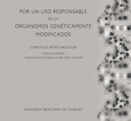
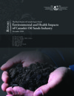

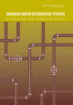
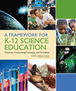
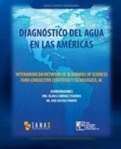
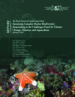
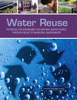
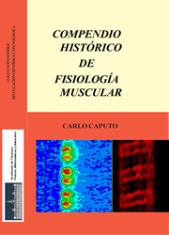

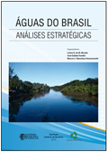
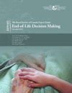
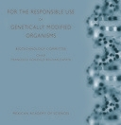
Capacity Building
Access to scientific information…

Slide 10
Science Communication
IANAS organized a workshop on Science Communication attended by science writers and journalists from throughout the Americas. This very successful event was hosted by the Argentinean Academy and received financial support from IAP and NAS.

Slide 11
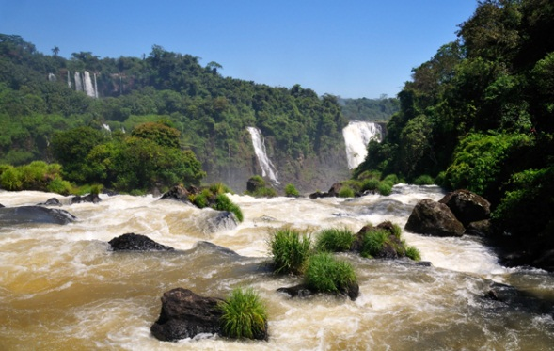
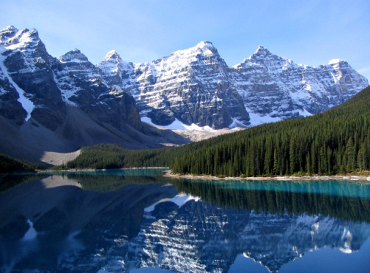
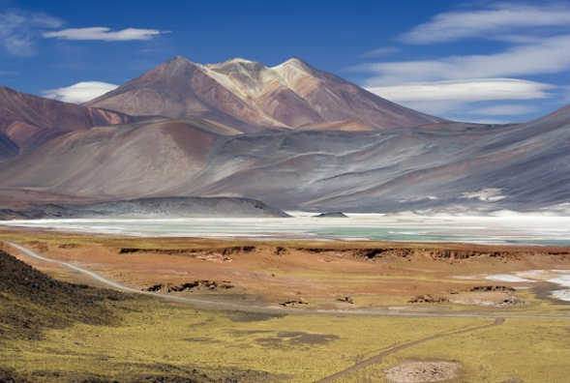
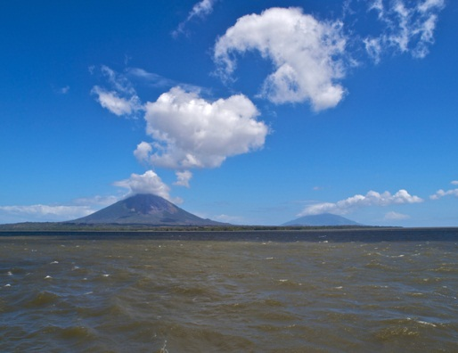
FOR IANAS
The challenges of water requires vigorous scientific, technological and managerial actions in order improve the use the existing supplies; recover degraded surface and groundwater reserves; and secure for the future generations the necessary water resources
IANAS Water Program
…

Slide 12
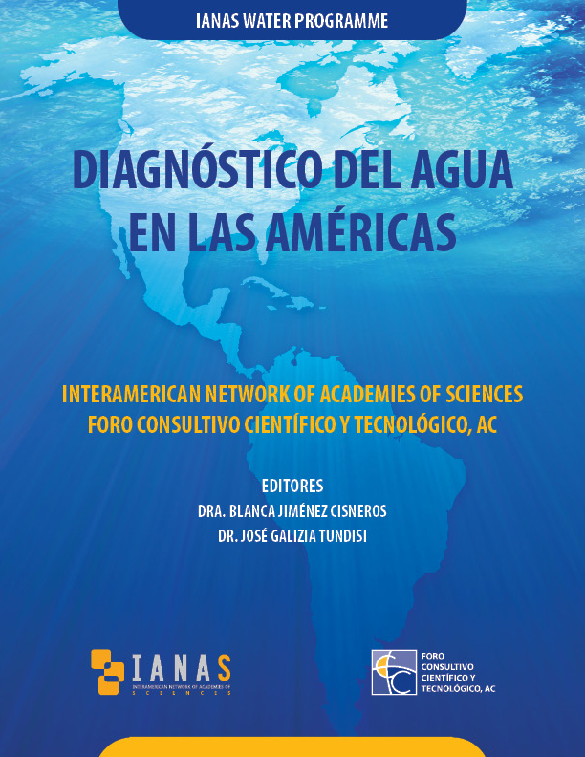
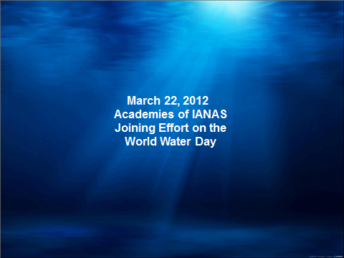
Water program

Slide 13
After the book presentation…

Slide 14
Energy Futures Workshop Buenos Aires based on IAC report

Slide 15


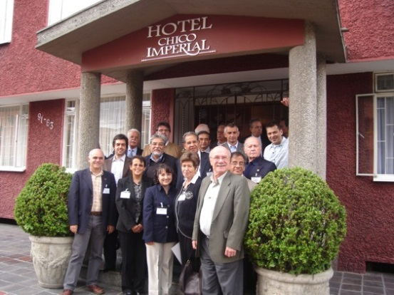
Lighting the Way; Toward a sustainable energy future
December 2010 and June 2011
Two Energy Program meetings with 16 points of contact on in Bogota, Colombia. Each participant presented an energy report of its country.
2012
La Paz, Boliva priorities and targeted actions:
  Energy for unserved populations.
  Renewable energy.
  Bioenergy.
  Energy Efficiency.
  Capacity Building (Innovation &Development)
  Crosscutting with IANAS:Women for Science and Water
The topics will be lead by experts from different countries to prepare the IANAS Energy publication.

Slide 16

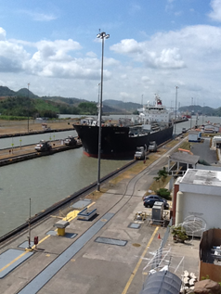
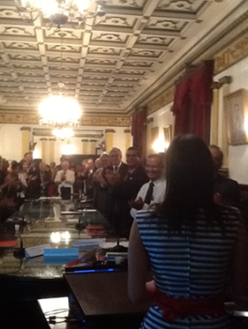

The results: Academies are actively engaged with the network
2011
Meetings in Brazil and Mexico with focal points of the Program helped define common needs and goals.
2012
“IANAS OWSD Women for Science Prize”, ceremony in Venezuela Clarimar Camacho, the awardee shared her hopes for a more inclusive society where “half of human kind should shares their part looking for a better world”
2013
This upcoming March 8, we will be launching the booklet “Women Scientists in the Americas. Their inspired stories” a common effort from Academies . The publication will be available at some of OAS sites.
IANAS Women for Science Program
Panama, 2012
“IANAS-Women for Science Prize”
Venezuela, 2012

Slide 17
The Bottom Line
It is critically important that science, and scientists, achieve a much higher degree of influence throughout the world!
Making international science organizations effective - An activist agenda

