Slide 1

Notes:
Mothers are the basis of families, babies are the future and the hope for the world

Slide 2

Notes:
But too many mothers and children die every year, Yes, more than half a million women die from pregnancy-related causes (that is 1 woman dying every minute). The vast majority of this deaths happen in developing countries, where the risk of women of dying giving birth can be as high as 100 times compare with a rich country.

Slide 3
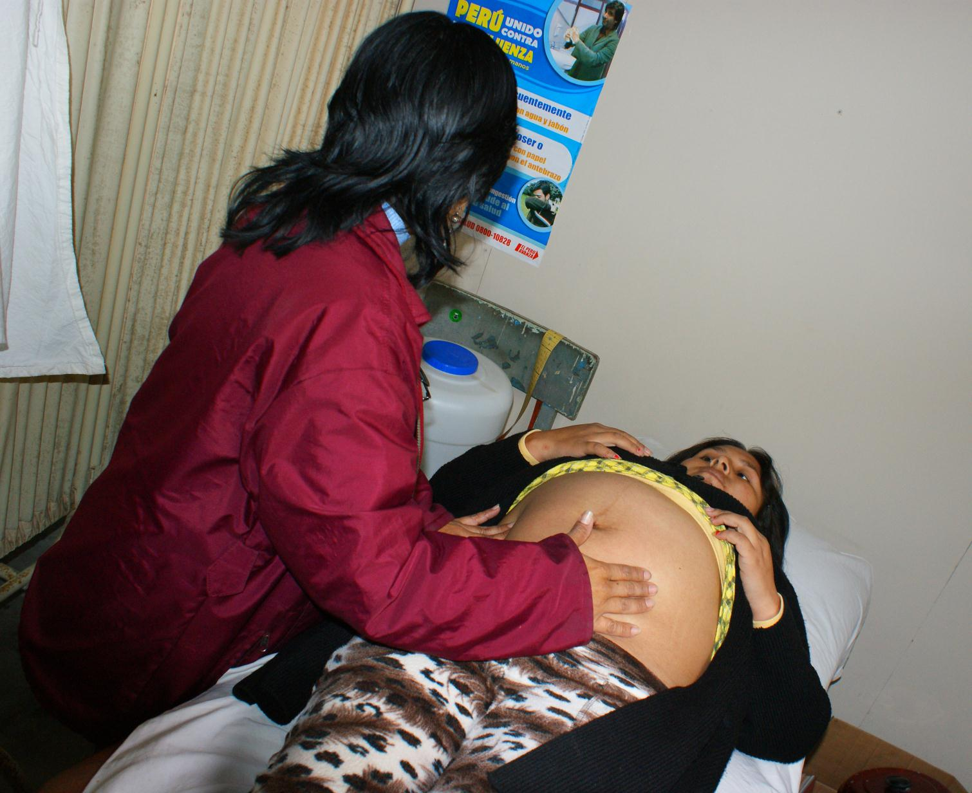
Notes:
Many of these deaths are preventable through simple interventions. Good antenatal care has been shown to prevent complications in pregnancy and improve newborn outcomes and the likelihood of a healthy child.

Slide 4
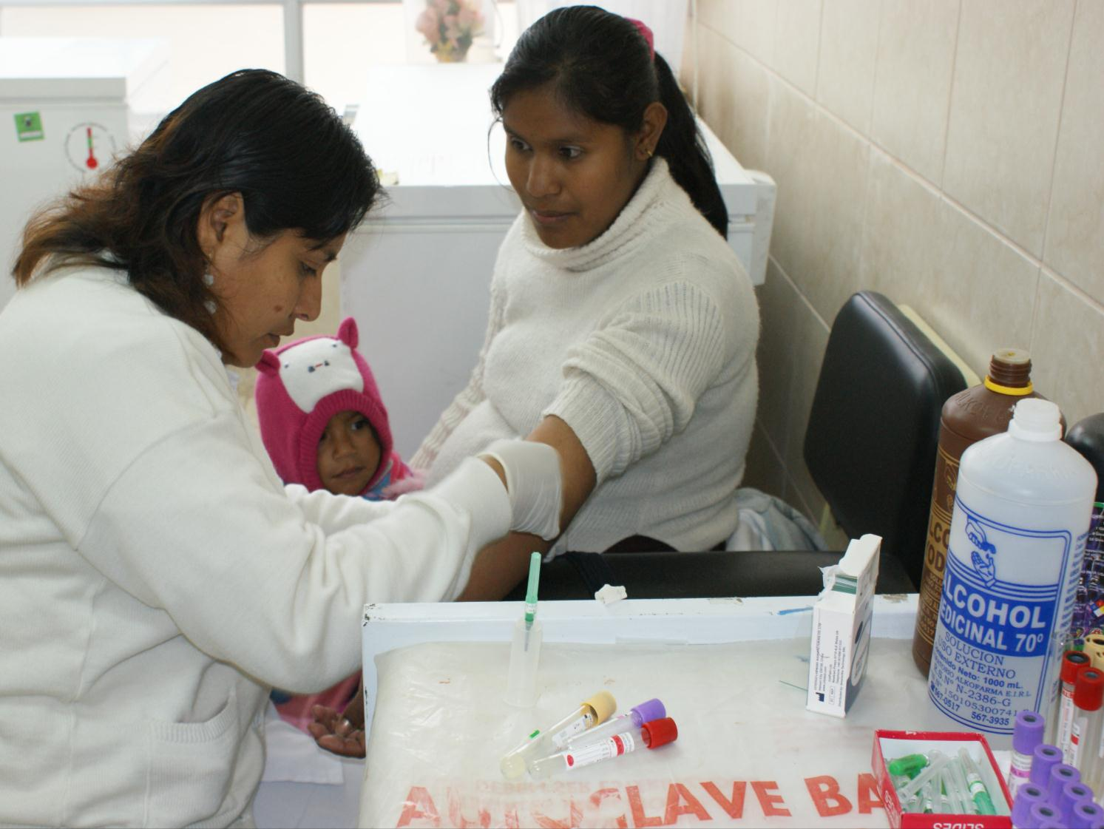
Notes:
But to have good ANC it is necessary to provide a basic package of diagnostic tests for example: blood tests for anemia, glucose, HIV, syphilis, and to test for endemic diseases (depending on the area), and urine tests for infection and a test for eclampsia.

Slide 5

Notes:
Unfortunately in developing countries the quality of antenatal care is poor. We lack laboratories, we lack highly trained staff, we lack tests, screening coverage is limited and results are not given in a timely manner.

Slide 6
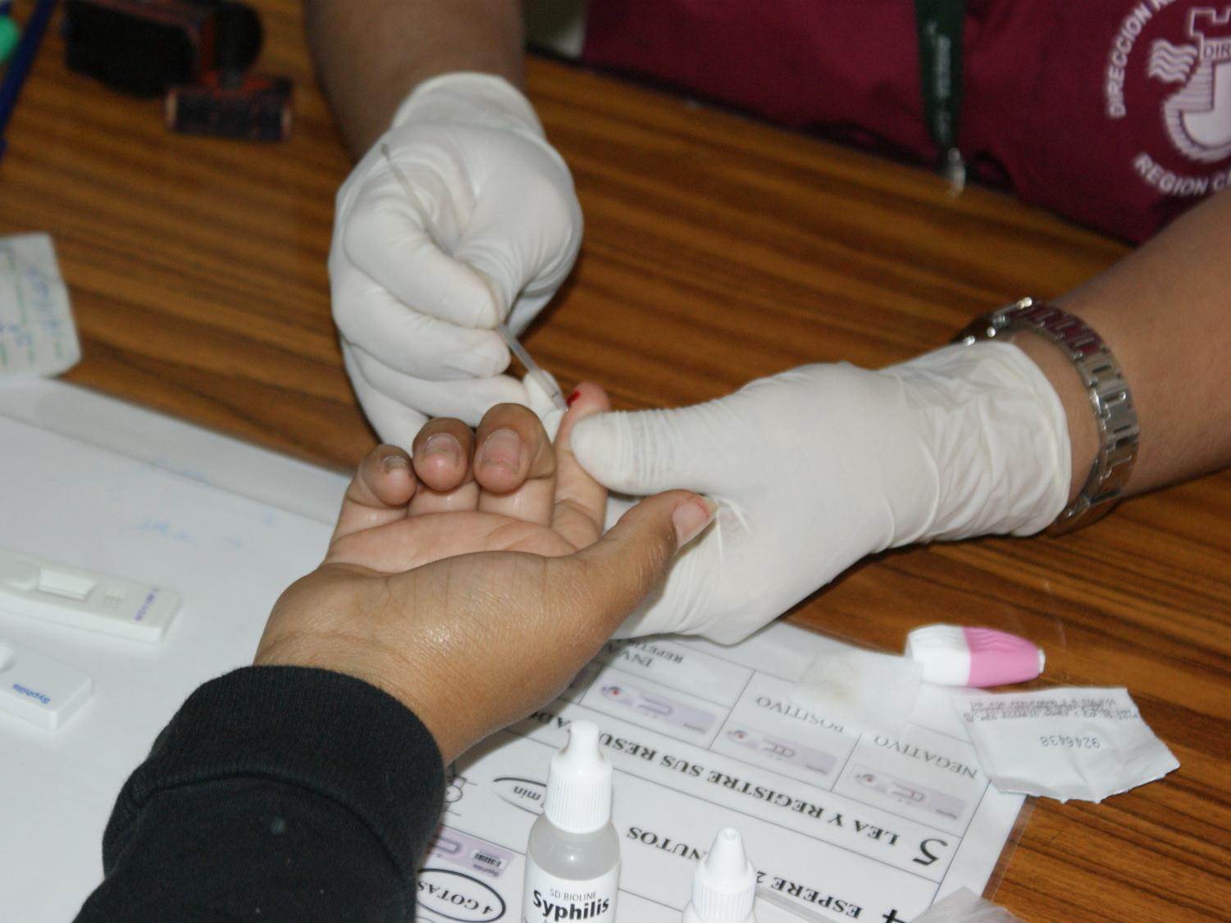
Notes:
Point of care diagnostics–the concept of a test which can be performed by the provider where the patient is– can improve service provision and outcomes in Maternal and child health and can decrease the large health inequality gap for women and children living in low-resource settings. Point of care tests ideally should give results within minutes or few hours, should be simple to use, should not require a laboratory, or highly trained staff.

Slide 7
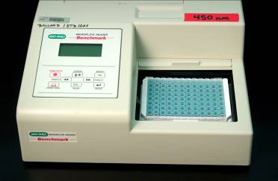
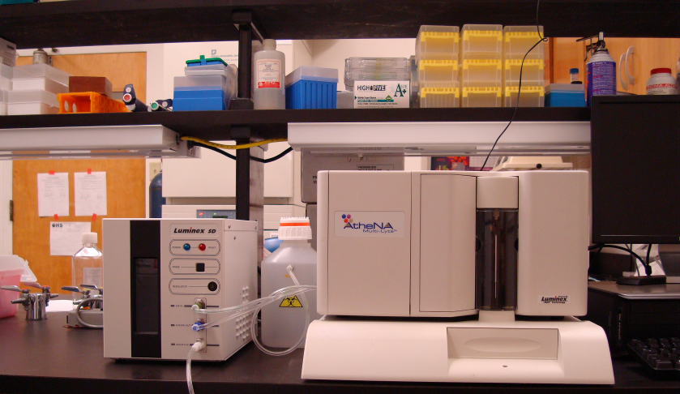

Notes:
The problem is the lack of Point of care tests that could be part of the package for maternal health for the top causes of maternal problems like eclampsia or urinary tract infections. We need them to be simple, reliable, accessible, “connected”, environmentally friendly and ideally “all in one package”.

Slide 8
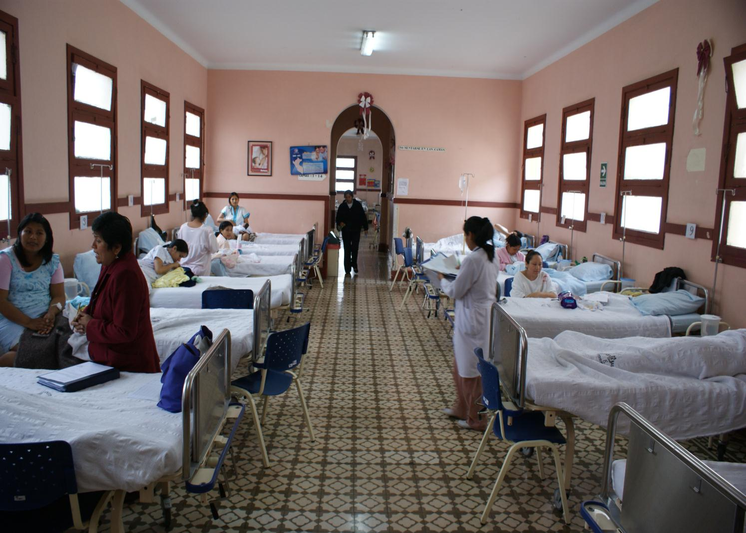
Notes:
This is one of the Eclampsia floors at a hospital in Peru. It is full of pregnant women, but some will not make it. Eclampsia is one of the leading causes of maternal and fetal mortality, and is seen in approximately 7% of pregnant women worldwide. Eclampsia causes high blood pressure, loss of proteins in the urine, abnormal liver and blood tests and seizures and death. Unfortunately, there is no single test to predict or diagnose eclampsia early in pregnancy and there is so much unknown about the mechanisms causing the disease.

Slide 9

GRAND CHALLENGE IN GLOBAL HEALTH
Improving maternal & child survival with appropriate diagnostic technologies (POCT) for the top causes of maternal problems, available where they are needed.
Notes:
So the grand challenge in global health I am presenting, is to work towards Improving maternal & child survival with appropriate diagnostic technologies (POCT) for the top causes of maternal problems, and assure availability where they are needed.
The answer to this challenge has to do with several disciplines working together.

Slide 10

Notes:
We need basic sciences to help in the development of biomarkers, engineering, information technologies (IT) to make them connected; implementation sciences, policy science, and business to assure the adoption of technology. Technology should be combined with other innovations to support eﬀective adoption and implementation.

Slide 11



GRAND CHALLENGE IN GLOBAL HEALTH
Improving maternal & child survival with appropriate diagnostic technologies (POCT) for the top causes of maternal problems, available where they are needed.
Notes:
We all want happy mothers and brilliant futures for our children, let´s take the challenge and start working now.

