Slide 1

On the Eight Domains
of Evidence Based
Policy Design
Ricardo Paes de Barros - SAE
Rio de Janeiro, fevereiro de 2013.

Slide 2
Evidence Based Policy Design
Recognizing progress
Identifying the determinants of progress
Identifying failures
Early detection of new trends
Ex-ante evaluation
Ex-post impact evaluation
Learning from others (meta-analysis)
Identifying programs with no impact

Slide 3
1. On the Importance of
Recognizing Progress

Slide 5
Notes:
5

Slide 6
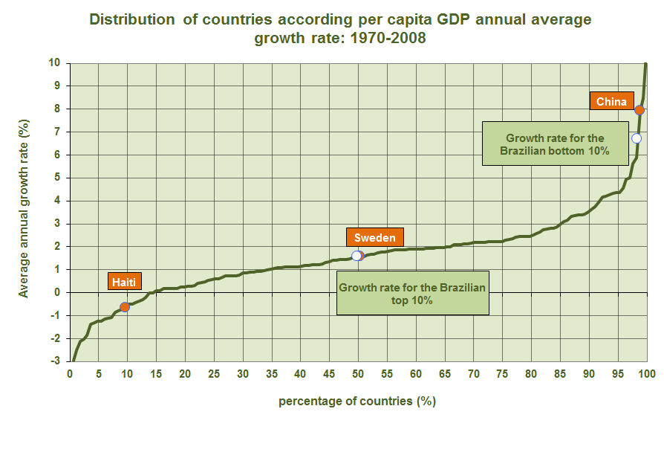

Slide 8
2. On the Importance
of Identifying the
Determinants of Progress

Slide 9
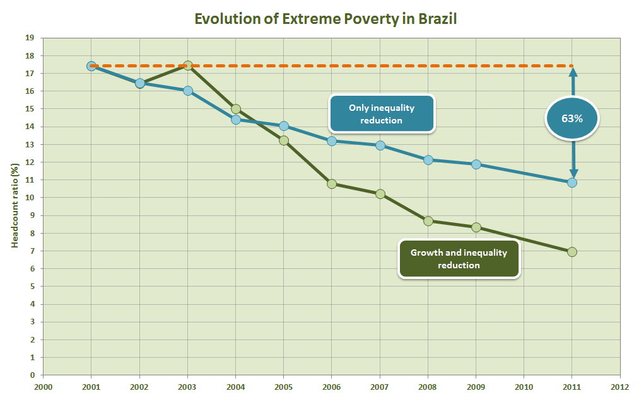

Slide 10
Basic Identity
per capita income
Non labor income per adult
Labor income per adult working
Percentage of adults
Percentage of adults working

Slide 12
3. On the Importance of
Recognizing Failure

Slide 15
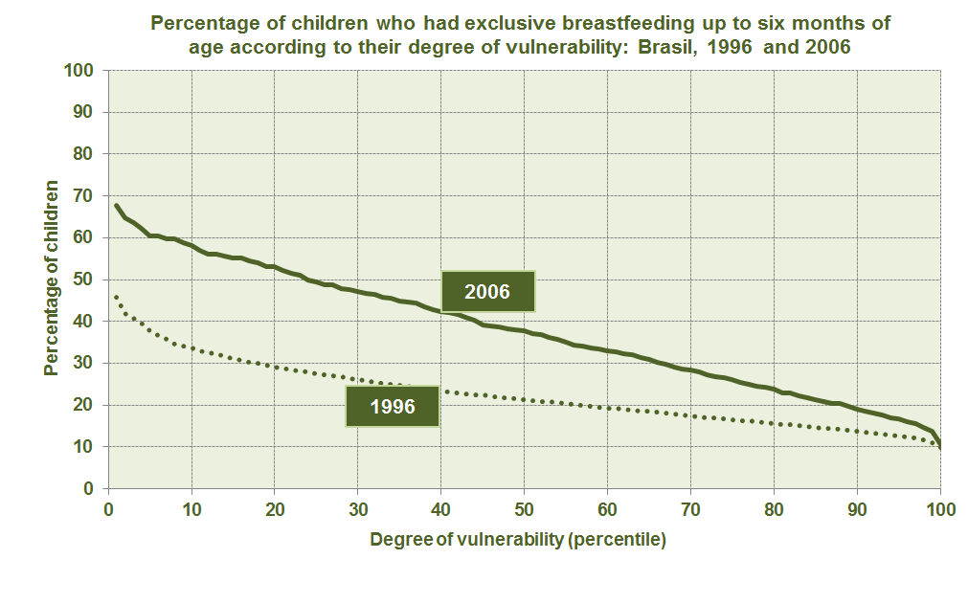

Slide 16
4. On the Importance of
Early Detection of New Trends

Slide 17
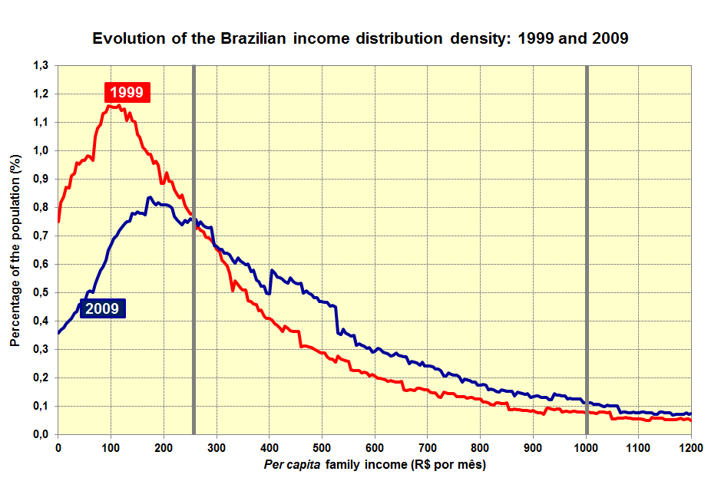

Slide 19
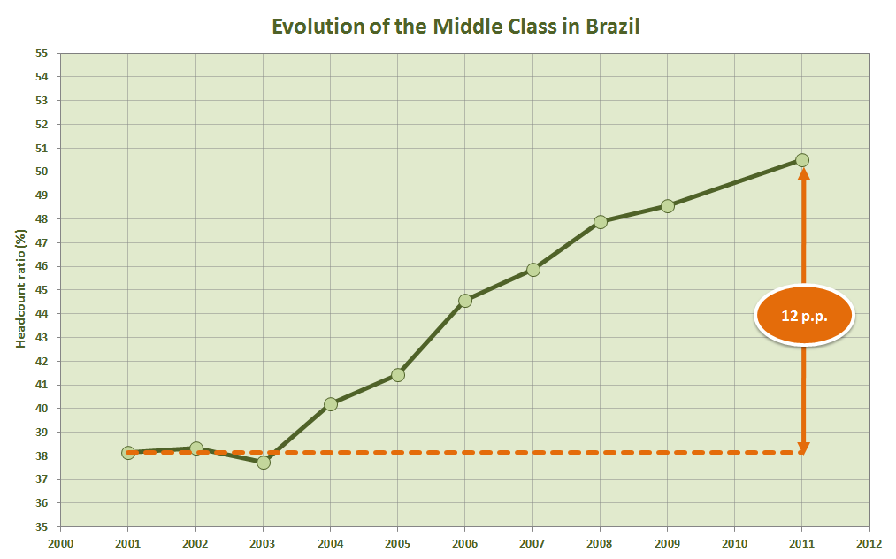

Slide 20
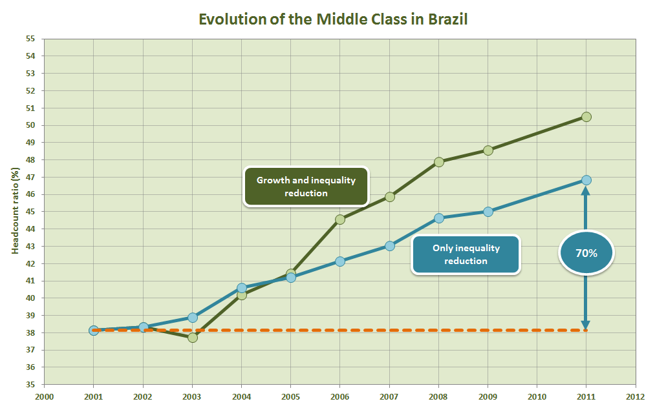

Slide 22
5. On the Importance of
Ex-Ante Evaluations

Slide 24
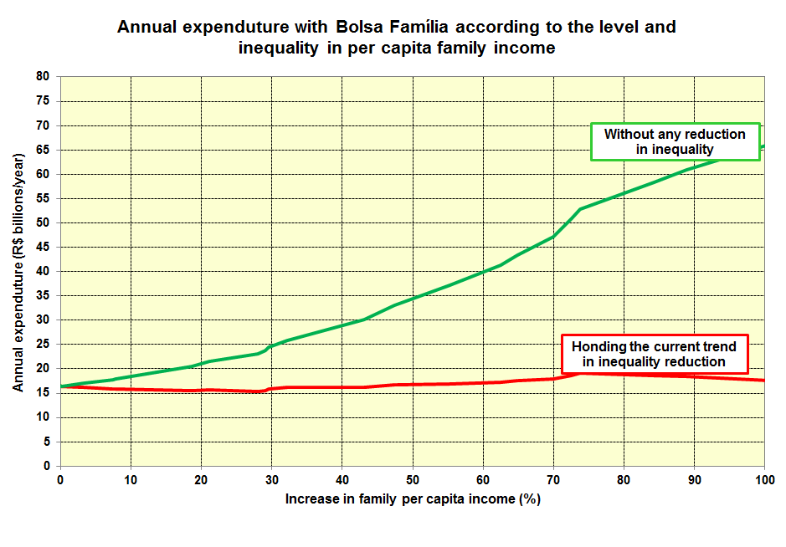

Slide 25
6. On the Importance of
Ex-Post Impact Evaluations

Slide 26
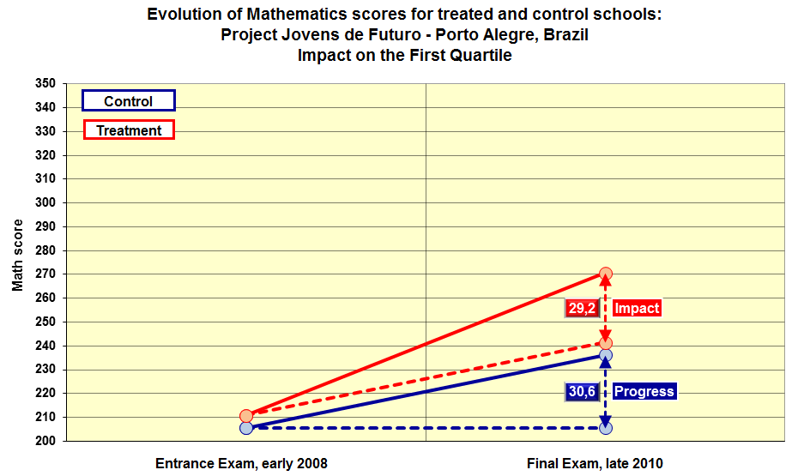

Slide 27
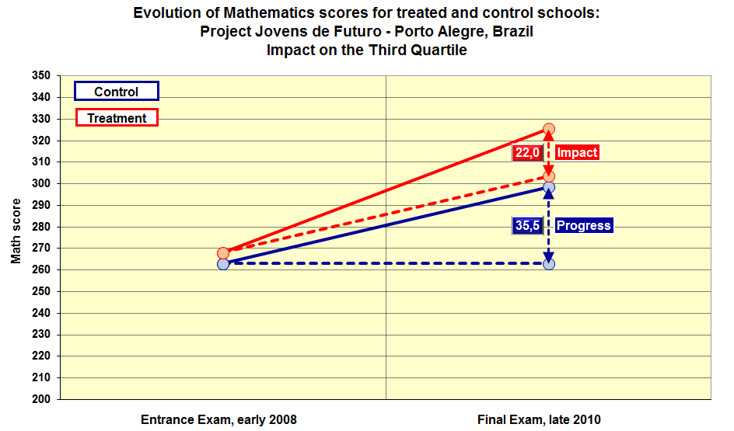

Slide 28
7. The Importance of Learning
from the Experience of Others
(meta-analysis)

Slide 29
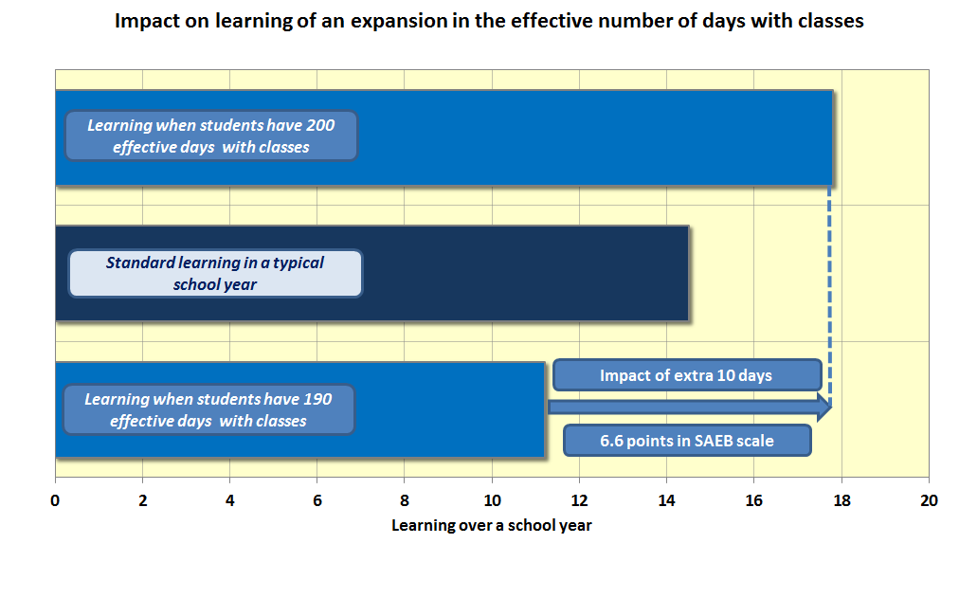

Slide 30
8. On the Importance of
Identifying Programs
with no Impact

