Slide 2
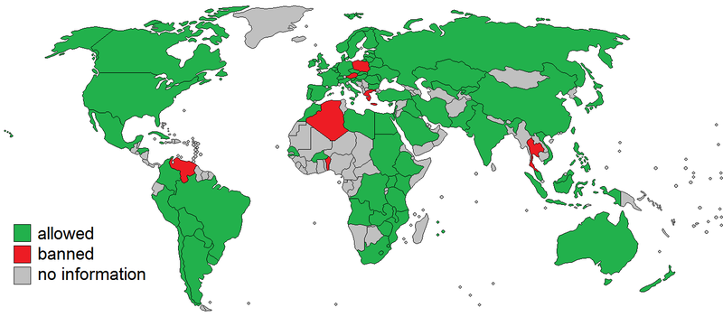
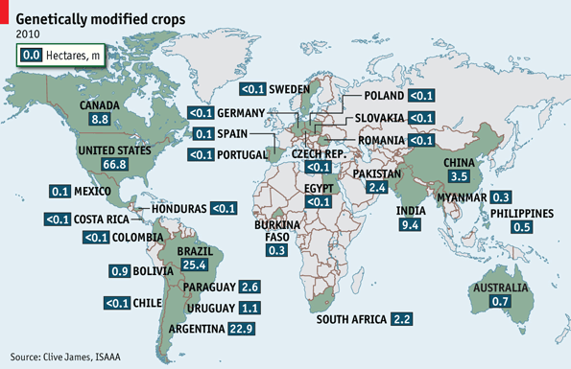
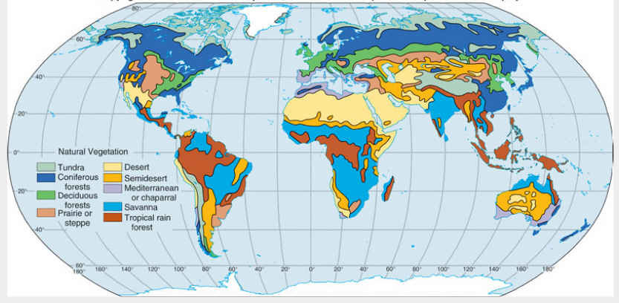

Slide 6
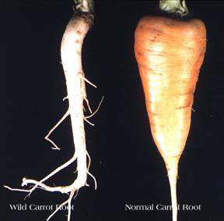

Slide 7
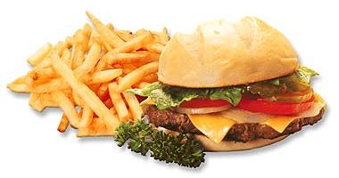
Cotton seed oil
Soy lecithin
Soy flour
Corn Syrup
Canola oil
Corn oil
Soybean oil
Cotton seed oil
Corn oil
Soybean oil
Cotton seed oil
Partially Hydrogenated
Soybean oil
Source: www.McDonalds.com

